Slide 1
Skin Disease Analysis
Member | Supervisor
Name: Arafat Rahman Reg. No: 200103020013 Semester: Spring-24 | Ayon Dey Lecturer, Dept. of CSE North East University Bangladesh

Slide 2
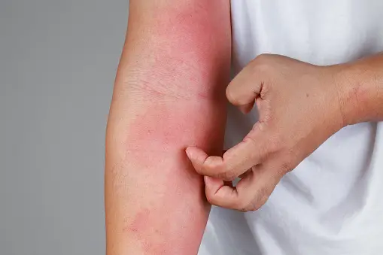
Introduction
In today's world, early and accurate diagnosis of skin diseases is crucial for effective treatment and management.
My project focuses on building a model that not only detects skin diseases but also determines whether they are cancerous.
www.istockphoto.com

Slide 3
Dataset
Dataset : Dermnet
Image Data: 19,500
The data consists of images of 23 types of skin diseases taken from http://www.dermnet.com/dermatology-pictures-skin-disease-pictures. The total number of images are around 19,500, out of which approximately 15,500 have been split in the training set and the remaining in the test set.

Slide 4
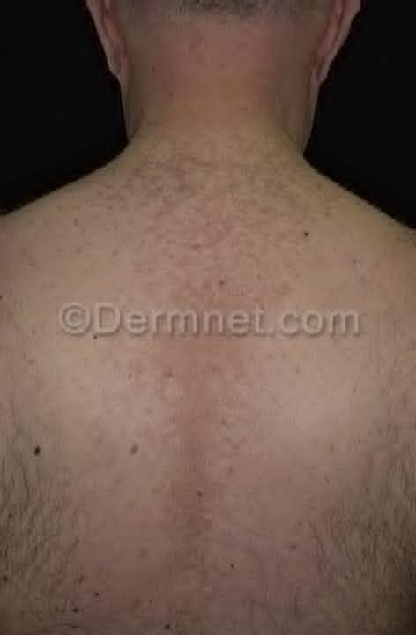
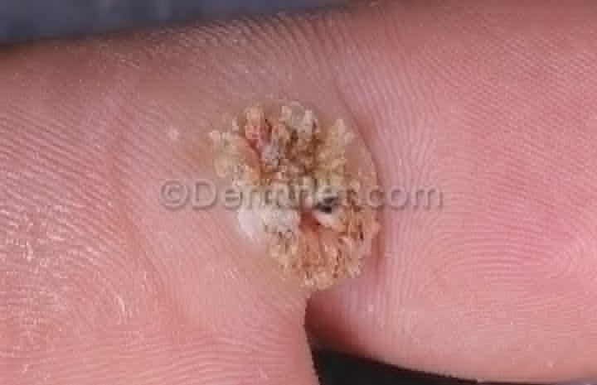
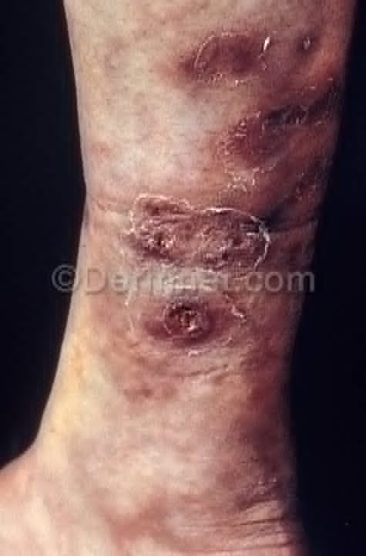
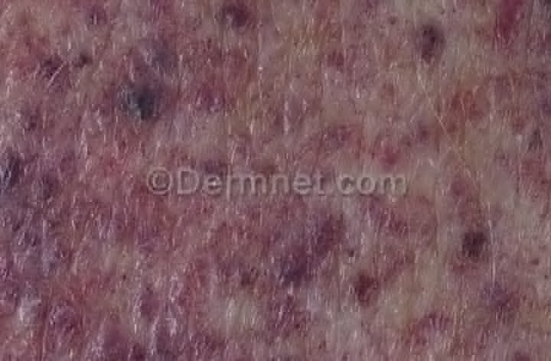
Dataset
wart
Wart
Tinea Versicolor
vasculalites tumour
vasculalities

Slide 5
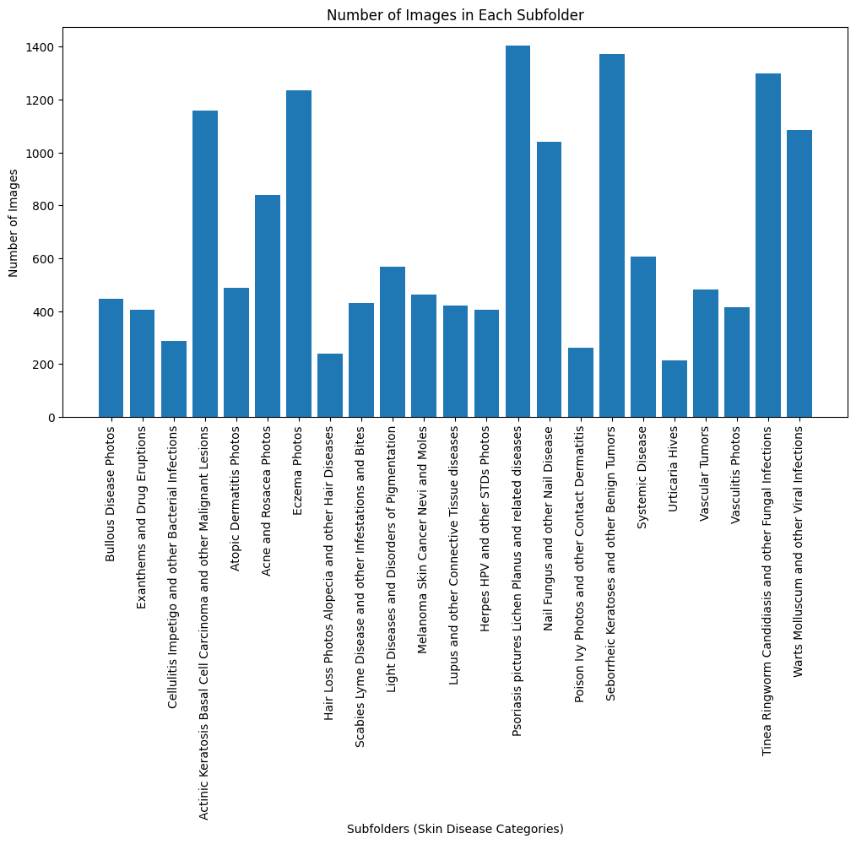
Dataset
Fig: Plot for the numbers of disease sample

Slide 6
Dilemma
Watermark problem which is having a great impact on model train accuracy and validation accuracy.
As convolution layers of ImagenetB2 works for each pixel.

Slide 7

Earlier Training the model
learning_rate=1e-5
Minimum Learning rate that the model will adjust to increase accuracy is 1e-7.
Model Training(ImagenetB2)

Slide 8

Completed Training
My model has been trained . And now it is able to classify diseases properly

Slide 9
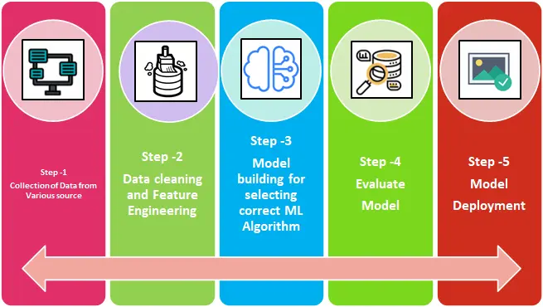
Completed work

Slide 10
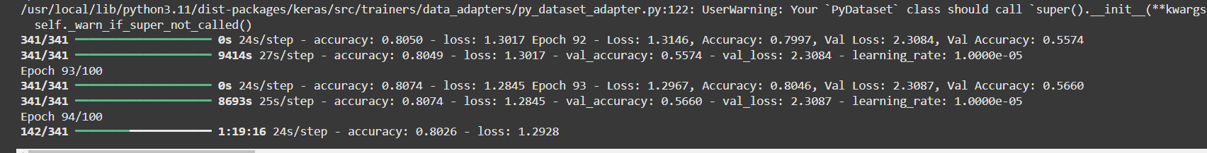
Final Work result(EfficientNetB2)
Train Set
======================
Accuracy: 0.89
Train Loss: 0.57
validation Set
======================
Accuracy: 0.60
Validation Loss:2.08

Slide 11
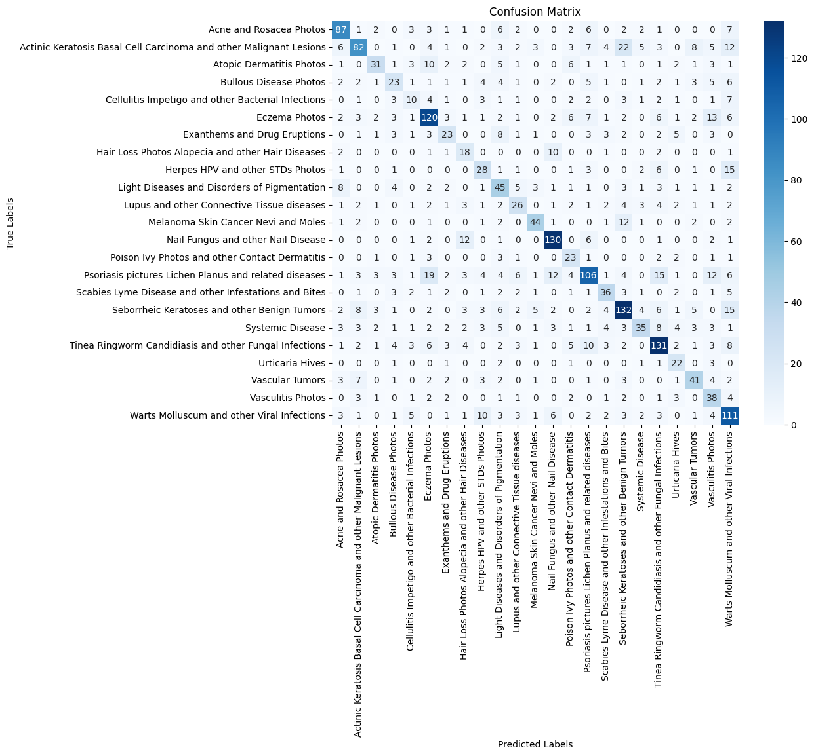
CONFUSION MATRIX:

Slide 12
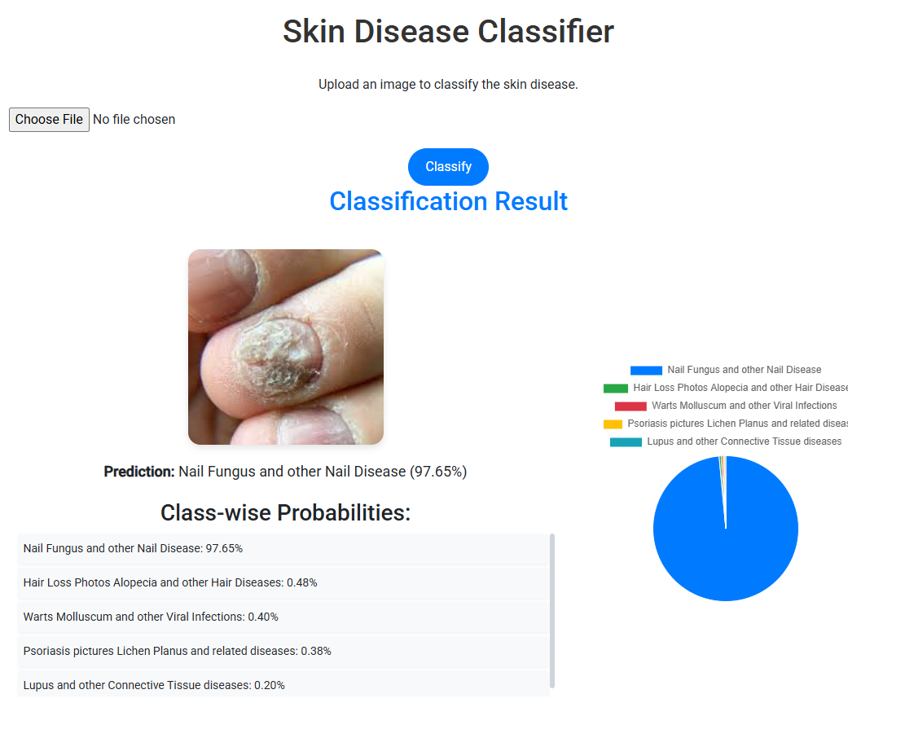
My Project Screenshot-1

Slide 13
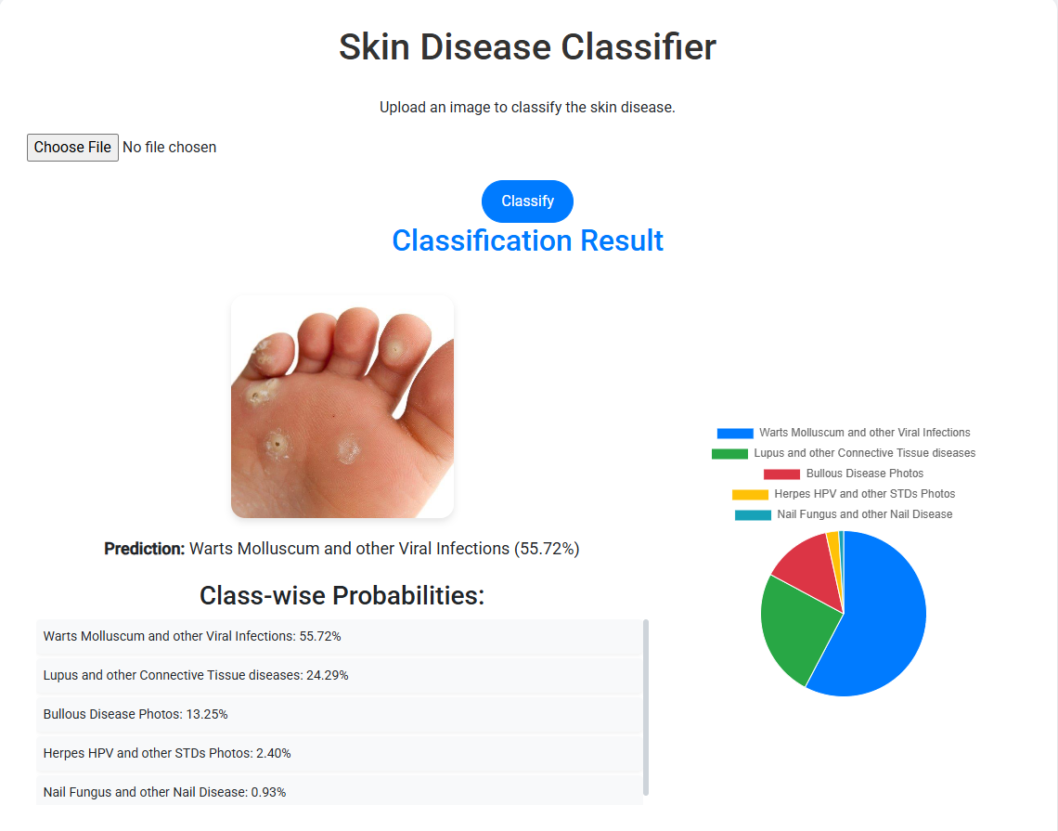
My Project Screenshot-2

Slide 14
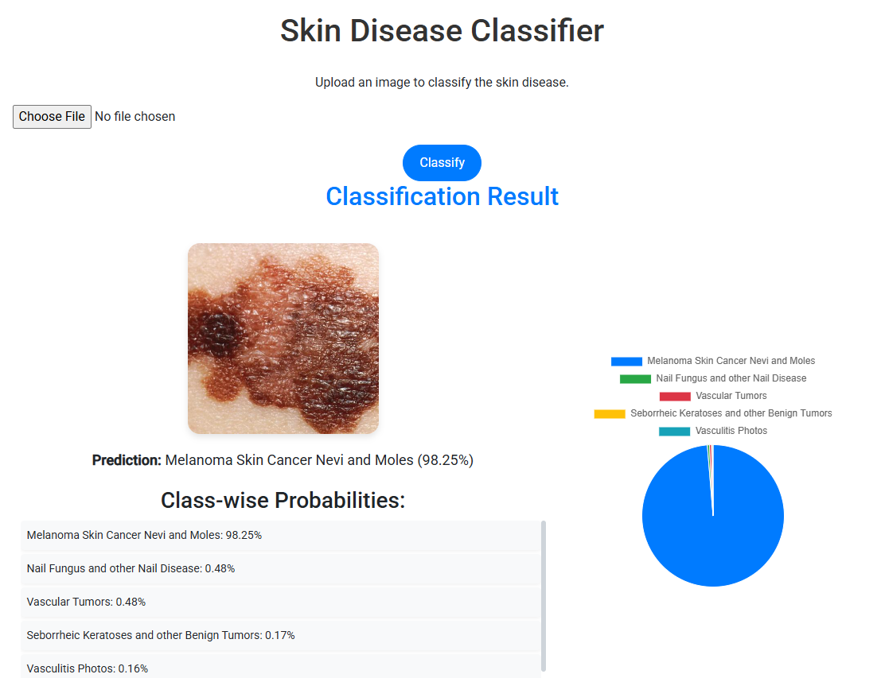
My Project Screenshot-3

Slide 15
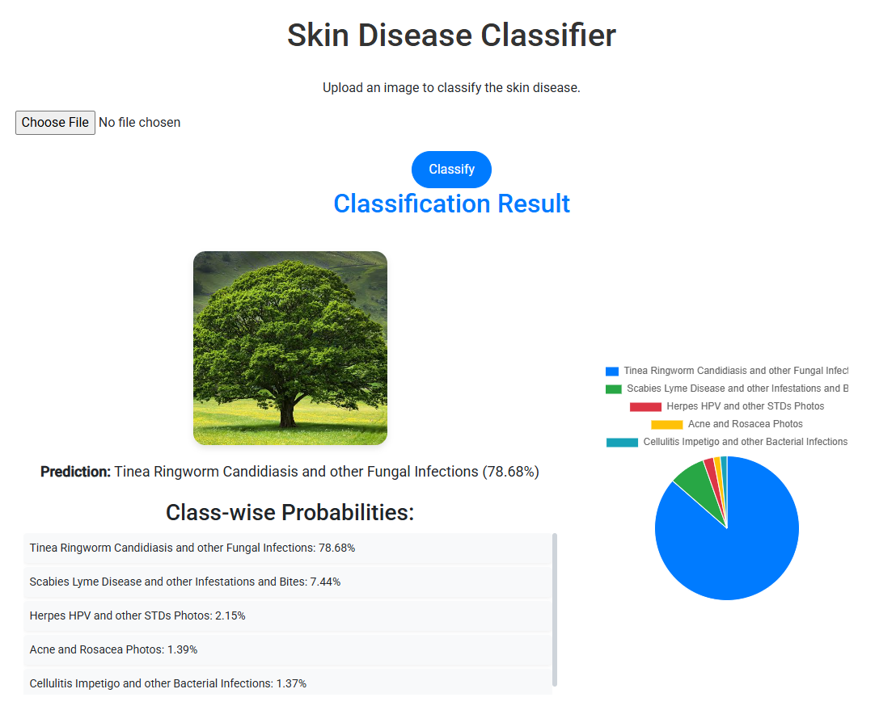
My Project Screenshot-4

Slide 16
Conclusion
This project on Skin Disease Analysis using CNN has progressed significantly through critical stages, including data collection, preprocessing, and initial model training and finally it has been deployed on the local server. Leveraging a dataset of 19,500 images across 23 skin disease types, the current model, built on EfficientNetB1, shows promising results. The ultimate goal is to develop and deploy a highly accurate model for early skin disease detection, contributing meaningfully to improved healthcare outcomes.
Although significant train loss has been noticed due to water mark on each Image I am sure to overcome it in future.

Slide 17
Thank You!
Do you have any question?

